Slide 1

Detecting forged/mis issued/fraudulent Certificates
in our current PKI
Survey Report
Abhishek Kejriwal
Rahul Sinha

Slide 2




What is the problem?
X.509 certificates being mistakenly/fraudulently issued by CAs for domains.
There are no effective mechanisms for domain owners for early detection if such an incident happens and thereby revoke them.
It may take months for such an incident to come to light.
Many SSL/TLS end users like us are being compromised and fall prey to SSL Man in the Middle attack.

Slide 3

Few incidents in the past
Dutch CA (DigiNotar) was compromised in 2011. Hackers were able to use the CA’s system to issue fake SSL certificates which were used to impersonate numerous sites like Gmail and Facebook. The CAs certificate was revoked and the CA was shut down.
Malaysian subordinate certificate authority (DigiCert Sdn. Bhd.), had mistakenly issued 22 weak SSL certificates which were used to impersonate different websites. Browser vendors had to revoke all certificates issued by DigiCert Sdn. Bhd.
Recently a large U.S.-based CA (TrustWave) issued subordinate root certificates to one of its customers on request as the customer wanted to monitor traffic on their internal network.
Moral of the Story: It is very easy for CA’s to make mistakes and the consequences of such mistakes may be very severe.

Slide 4
Some existing mitigations against illegitimate SSL certificates

Slide 5
HTTP Strict Transport Security (HSTS) and
Certificate Pinning
HTTP Strict Transport Security (HSTS) is a simple protocol where the server simply instructs or makes it mandatory for the browser to establish a SSL connection rather than simple HTTP connection. According to the HSTS protocol a browser simply hard fails to connect to website if any warning pops up reflecting invalid certificates.
Public key pinning for HTTP (HPKP) is a mechanism where the websites are allowed to sign a certificate with their own public keys. The websites ask the browser to reject any certificate that does not has its public key pinned to it thereby signaling the browser of the possible man in the middle attack.
Trust Assertion for Certificate Keys (TACK) is a mechanism which makes use of the SSL servers over which the websites establish a secure connection with the browser. The server chooses a signing key different from the key chosen by the certificate, so that it allows websites with multiple SSL servers and multiple certificates to sign a same TACK signing key.

Slide 6






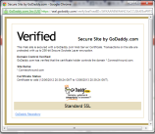
Perspectives and Convergence
Perspectives and Convergence introduces the concept of Network Notaries.
Once the SSL connection is established, the browser receives the certificate from the server and matches with the certificate it has in its cache.
If the certificate is doubtful then the browser can approach any number of notaries and query them about the legitimacy of the certificate.
Based on the majority of positive replies from the notaries, the browser takes a call.
N₁
N₂
……
N_{n}
Web
Server
Browser

Slide 7
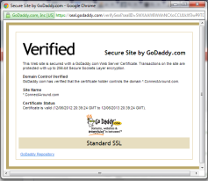
Direct Validation Certificate
The server stores all the certificate it might use for that particular session in a data structure called the Domain Certificate List.
After the browser sets up a connection with the server the browser authenticates the server using a DV Cert transaction.
Once the DV Cert transaction is successfully established, the browser receives the DCL form the server and maintains this DCL received as a temporary storage at its own end.
When the browser receives the certificate from the server, it checks the certificate received with the certificate present in the DCL.
If the certificates don’t match then the SSL connection is broken.
SERVER
BROWSER
DCL
DCL

Slide 8

DNS based Authentication of Named Entities
(DANE)
Web
Server
DNS
ZONE
The browser would first query the DNS about its IP address and TLSA records.
The DNS sends a response to the browser with its IP address and TLSA records.
Now the browser connects to the web server to see whether the certificate it received has the signature of the domain that it had already queried.
If the information received from the certificate doesn’t matches the information
it had already received from the DNS then the connection is refused.

Slide 9


Certificate Authority Authorization (CAA)
Suppose a domain owner owns a domain “abcd.com” and it has created a Certificate Authority Authorization (CAA) record listing the CA’s that are eligible to provide certificate for the domain..
Domain
Owner
Attacker
Now lets assume that an attacker wants a certificate for the domain from CA1.
abcd.com
The CA 1 checks if it is listed in the Certificate Authority Authorization (CAA) Records.
Certificate
Authority
Authorization
Records
CA 1 is informed of its absence from the list.
CA 1
CA 1 will then notify the domain owner about the request to issue a certificate, that it had received from an external user. It is then upon the domain owner to decide whether he wants to add CA 1 to the CAA records, or deny the request.
CA 2
CA 3
CA 4
CA 5

Slide 10
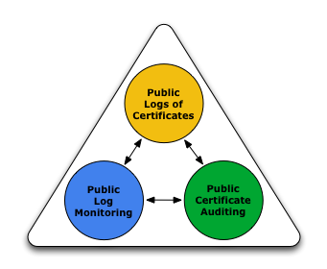
Certificate Transparency to the rescue
Open framework for monitoring and auditing digital certificates in the current PKI model through a system of
1)Certificate logs
2)monitors
3)auditors.
Fig reference : http://www.certificate-transparency.org

Slide 11
Goals of Certificate Transparency
Make it impossible or very difficult for a CA to issue a certificate for a domain without this certificate getting noticed by the domain owner.
Provide an open framework which lets domain owners or CAs to determine whether certificates have been mistakenly or maliciously issued.
Protect end users. If the first two points are met, the SSL/TLS end users are by default in a safe place unlike the other certificate revocation mechanisms.

Slide 12
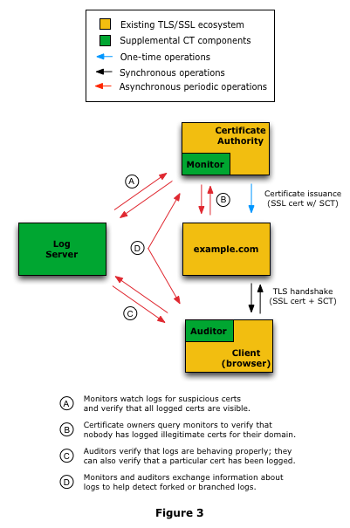
Basic Architecture
Fig reference : http://www.certificate-transparency.org

Slide 13
Certificate Logs/Log server
Certificate logs are generally log servers that contain cryptographically assured, publicly auditable, append only records of certificates that have ever been issued till date.
Whenever a CA issues a certificate to a domain say www.example.com, the CA submits the certificate it has issued to the log server.
Whenever a CA submits a certificate it has issued to a log server, the server responds back with a Signed Certificate Timestamp (SCT) which is a proof that the CA has requested the log server to append a new certificate and that the log server has acknowledged it by saying “Yes, I got the certificate. And I promise that the certificate will appear in my log within a certain time period”. This time period is called the maximum merge delay (MMD), the time taken for a certificate to get reflected on the log.

Slide 14
Monitors
Monitors are basically servers which are maintained by CA’s or domain owner themselves, and they continuously contact the log servers and check if any unexpected certificates for a domain appear on the log servers or check for certificates which have unusual certificate extensions and permissions like that of a CA.
Monitors will be run by domain owners such as Amazon, Google, or a bank, or any Government Organization. There will also be service providers who will provide monitoring services for those customers who do not wish to set up their own monitors.

Slide 15
Auditors
Auditors may be an integrated component of the end users web browser and they perform two functions.
They verify that log servers are behaving properly and they are consistent cryptographically. Whenever an end user receives a certificate after an SSL/TLS handshake, apart from the normal path validation process, now the auditor also checks if the certificate it received has been registered in a log or not.
If the certificate has not been registered in any log, that certificate might have reasons for not being trusted.

Slide 16
SSL/TLS handshake with Certificate Transparency
Now whenever a SSL/TLS client performs an SSL handshake with www.example.com, it receives the certificate having the SCT (provided by the log server in the first place).
The existence of this SCT proves that the certificate has been logged in some log server.
The auditor on the end user then queries the log server to check if the SCT has indeed been signed by that log server and also checks if the certificate has been legitimately added to this log server.
If the results are unexpected, the client can decide to not trust the certificate it received and hence terminate the SSL connection to www.example.com.
When Certificate Transparency gets deployed on a large scale, it is desirable not to trust a certificate which has no SCT, meaning it has not been logged in any log server.

Slide 17
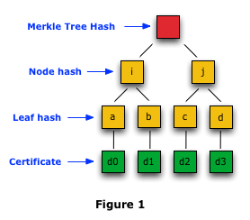
How Log Proofs work?
Certificate Transparency uses Merkle hash tree to facilitate public auditing of certificate and logs.
A Merkle hash tree is a simple binary tree containing hashed leaves and nodes.
Log Proofs are of two types
Consistency Proofs
Audit proofs
Fig reference : http://www.certificate-transparency.org

Slide 18
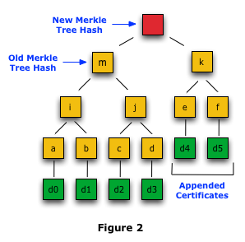
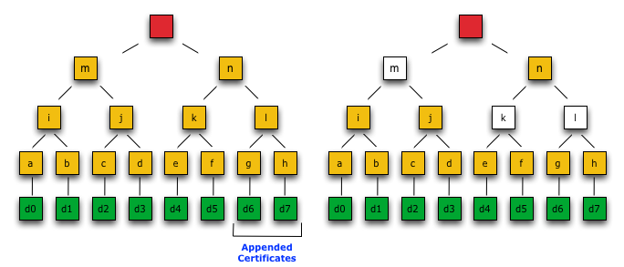
Consistency Proofs: to make sure log is behaving properly
Version 1
Version 2
Version 3
Fig reference : http://www.certificate-transparency.org

Slide 19
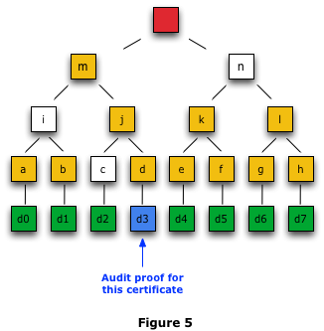
Audit Proofs: to make sure a specific certificate is included in the log
Fig reference : http://www.certificate-transparency.org

Slide 20
Benefits of Certificate Transparency
These benefits are mainly aimed at certificate authorities, domain owners, and server operators, but they also affect individual users.
Log servers provide a fantastic framework for monitoring and auditing any certificates issued till date.
If a CA goes rogue, it is very easy for domain owners to detect any illegitimate certificate issued for their domain using the monitor services provided by the CA or their own monitors.
Consistency Proofs and Audit Proofs provided by logs helps determine if a log is behaving consistently or not, and whether a Certificate received by an end user is logged in one and hence legitimate.
With the use of SCTs it becomes very much easy for an end user browser to detect if a certificate is a legitimate one or not.
With all these in place, revocation can be done much early as the detection process is speeded up.

Slide 21
References
“Analyzing Forged SSL Certificates in the Wild”, by Lin-Shung Huang, Alex Ricey, Erling Ellingseny, Collin Jackson
“Ten Risks of PKI: What You’re not Being Told about Public Key Infrastructure”, By Carl Ellison and Bruce Schneier.
“Can We Eliminate Certificate Revocation Lists?” By Ronald L.Rivest
A response to “Can We Eliminate Certificate Revocation Lists?”, by Patrick McDaniel and Aviel Rubin
“X.509 Forensics: Detecting and Localising the SSL/TLS Men-in-the-Middle” by Ralph Holz, Thomas Riedmaier, Nils Kammenhuber, Georg Carle
“Efficient Certificate Revocation List Organization and Distribution”, by Jason J. Haas, Yih-Chun Hu, and Kenneth P. Laberteaux
“A Distributed Online Certificate Status Protocol with a Single Public Key”, by Satoshi Koga and Kouichi Sakurai
“SoK: SSL and HTTPS: Revisiting past challenges and evaluating certificate trust model enhancements”, by Jeremy Clark and Paul C. van Oorschot
“Analysis of the HTTPS Certificate Ecosystem”, by Zakir Durumeric, James Kasten, Michael Bailey, J. Alex Halderman
“The Secure Sockets Layer (SSL) Protocol Version 3.0”, Request for Comments: 6101, IETF

Slide 22
“Internet X.509 Public Key Infrastructure Certificate and Certificate Revocation List (CRL) Profile”, Request for Comments: 5280, IETF
12. “Internet X.509 Public Key Infrastructure Online Certificate Status Protocol - OCSP”, Request for Comments: 5912, IETF
13. “Certificate Transparency”, Request for Comments: 6962, IETF (In draft)
14. "Digital Certificate Revocation" by Sally Vandeven, Walter Goulet
15. "Trust No One Else: Detecting MITM Attacks Against SSL/TLSWithout Third-Parties" by Italo Dacosta, Mustaque Ahamad, and Patrick Traynor
16. "Upgrading HTTPS in mid-air: An empirical study of strict transport security and key pinning" by Michael Kranch, Joseph Bonneau
17. "Perspectives: Improving SSH-style Host Authentication with Multi-Path Probing" by Dan Wendlandt, David G. Andersen, Adrian Perrig
18. "PKI Basics - A Technical Perspective" by Shashi Kiran, Patricia Lareau, Steve Lloyd
19. "Reducing the X.509 Attack Surface with DNSSEC’s DANE" by Eric Osterweil, Burt Kaliski, Matt Larson, Danny McPherson
20. "https://tools.ietf.org/html/rfc6698" - DNS based Authentication of Named Entities

Slide 23
21. "https://tools.ietf.org/html/rfc6844" - DNS Certification Authority Authorization (CAA) Resource Record
22. http://perspectives-project.org/
23. http://tack.io/
24. http://www.certificate-transparency.org
25. www.google.com
26. www.Wikipedia.org
27. www.youtube.com
28. www.stackoverflow.com

